Slide 1
Android 07 – Using Intent

Slide 2

Using Intent

Slide 3
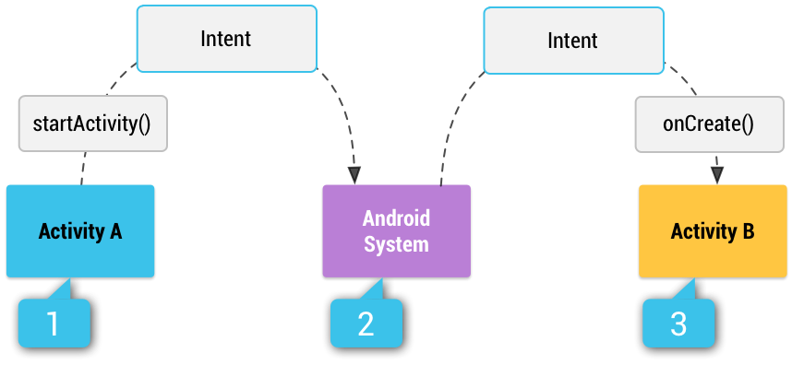
Introduction - Intent
Android intent is the message that is passed between components such as activities, content providers, broadcast receivers, services etc.
It is generally used startActivity() method to invoke intent object from its android.content.Intent class.
Android intents are mainly used to:
Start the service
Launch an activity
Display a web page
Display a list of contacts
Broadcast a message
Dial a phone call

Slide 4
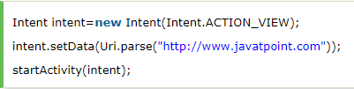


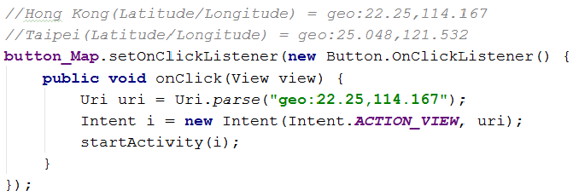
Implicit Android Intent
Implicit intent
does not specify the component, it provides information of available components from the other third party apps.
To view the webpage:
To dial a phone call:
To check on map:

Slide 5

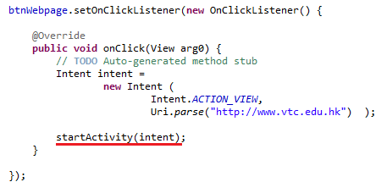
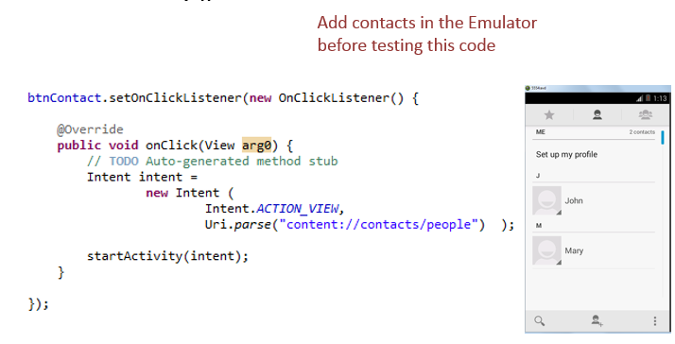
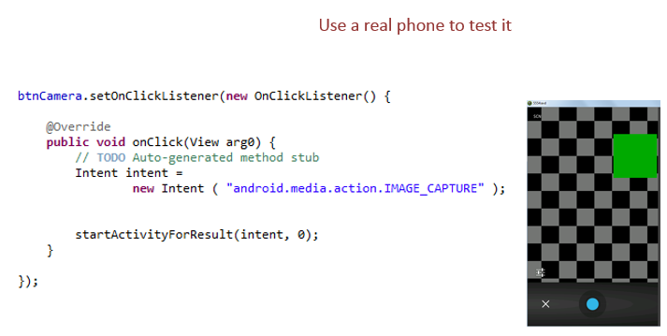
Implicit Android Intent (2)
To show webpage:
To show contacts:
To show camera:

Slide 6
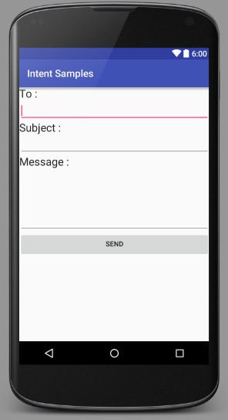

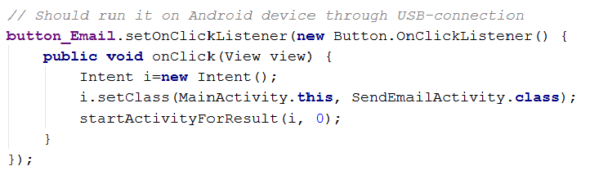
Explicit Android Intent
Explicit intent
Need to specify the component, it provides the external class to be invoked from our own app.
General syntax:
activity_email.xml with SendEmailActivity.java to handle the events
Given an example with activities Main to SendMail:

Slide 7
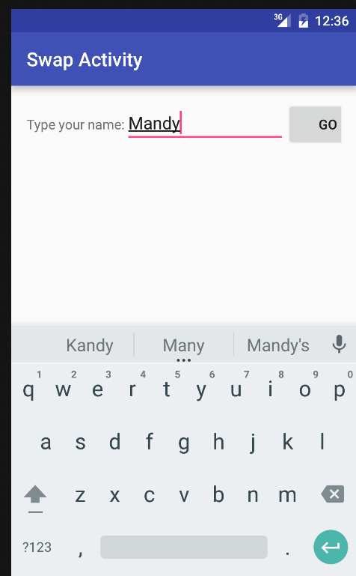
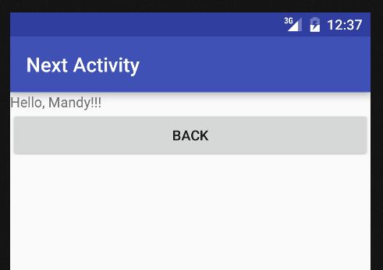
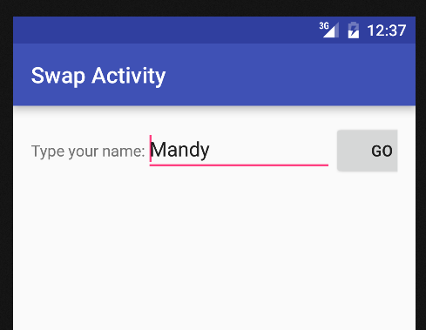
Exp. Intent E.g. – Swap Activity
Use Explicit Intent to swap activity

Slide 8
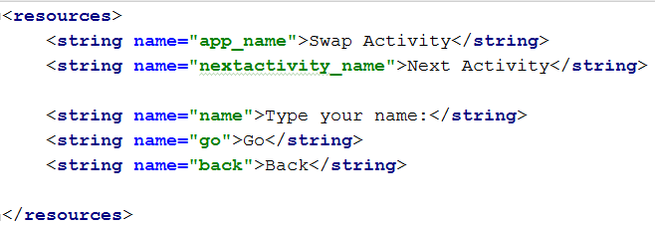
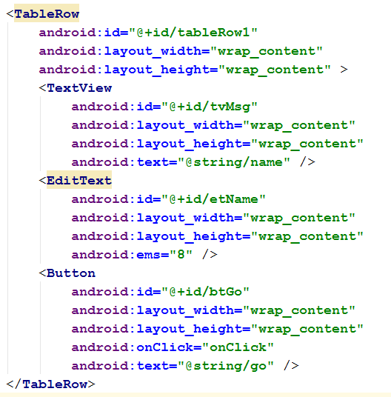
Exp Intent E.g. – res/values/strings.xml
activity_main.xml

Slide 9
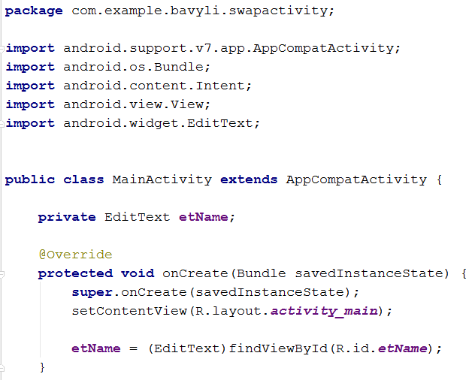
Exp Intent E.g. – MainActivity.java (1)

Slide 10
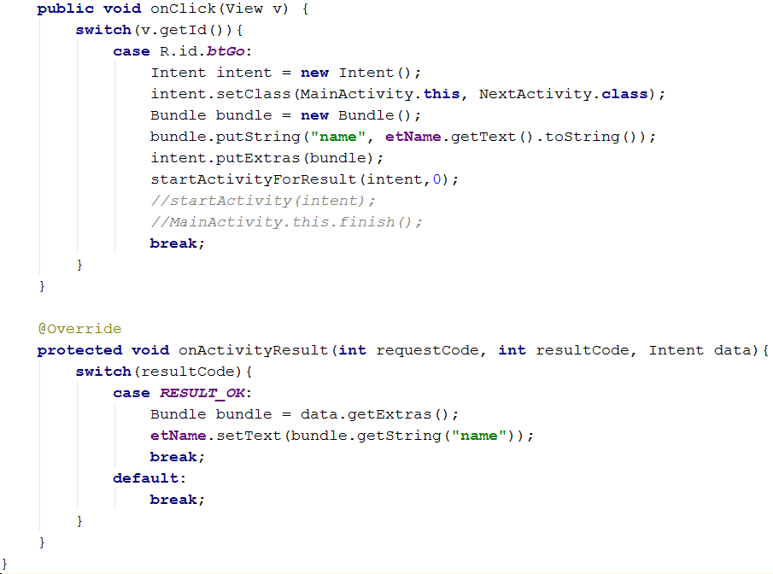
Exp Intent E.g. – MainActivity.java (2)

Slide 11
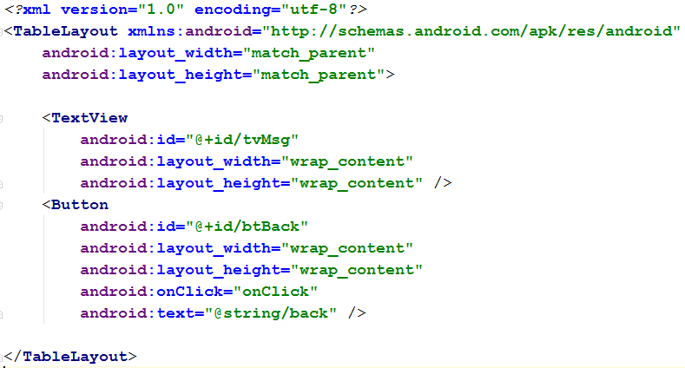
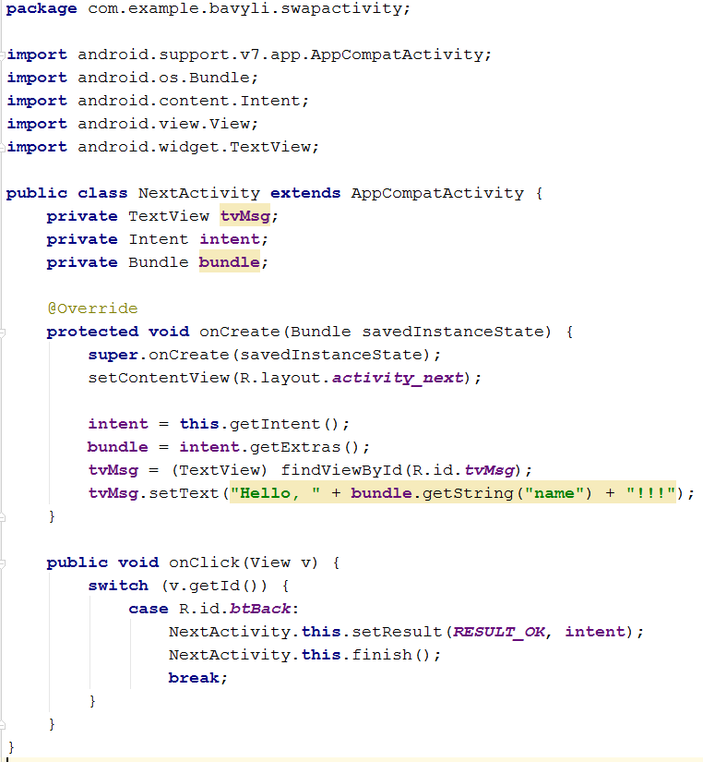
Exp Intent E.g. – activity_next.xml
NextActivity.java

Slide 12
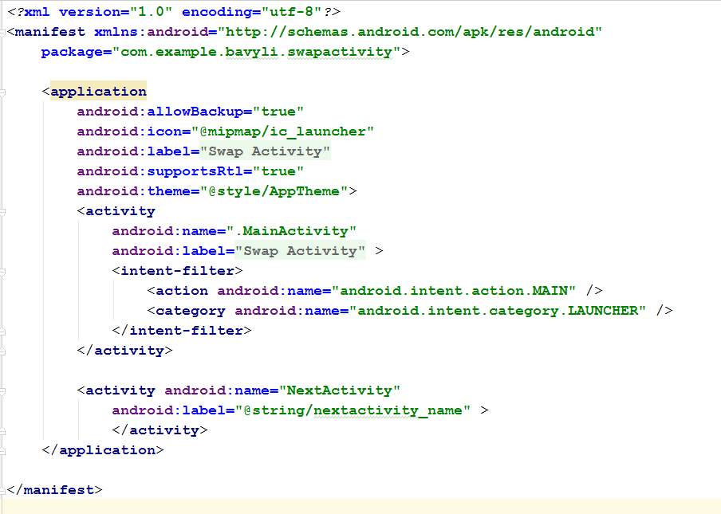
Exp Intent E.g. – AndroidManifest.xml

